Slide 1

Proposal Presentation
Development and Validation of a Dexterous Hand System
··· Dexhand Designed by The Robot Studio···
Team Members: Jincheng Tian, GuangTian Liu, ZhongHao Zhao
2026/3/11
Notes:
Hello,everyone. We are group2, and we focus on dexterous right hand. So our project is about Development and Validation of a Dexterous Hand System which designed by the robot studio

Slide 2
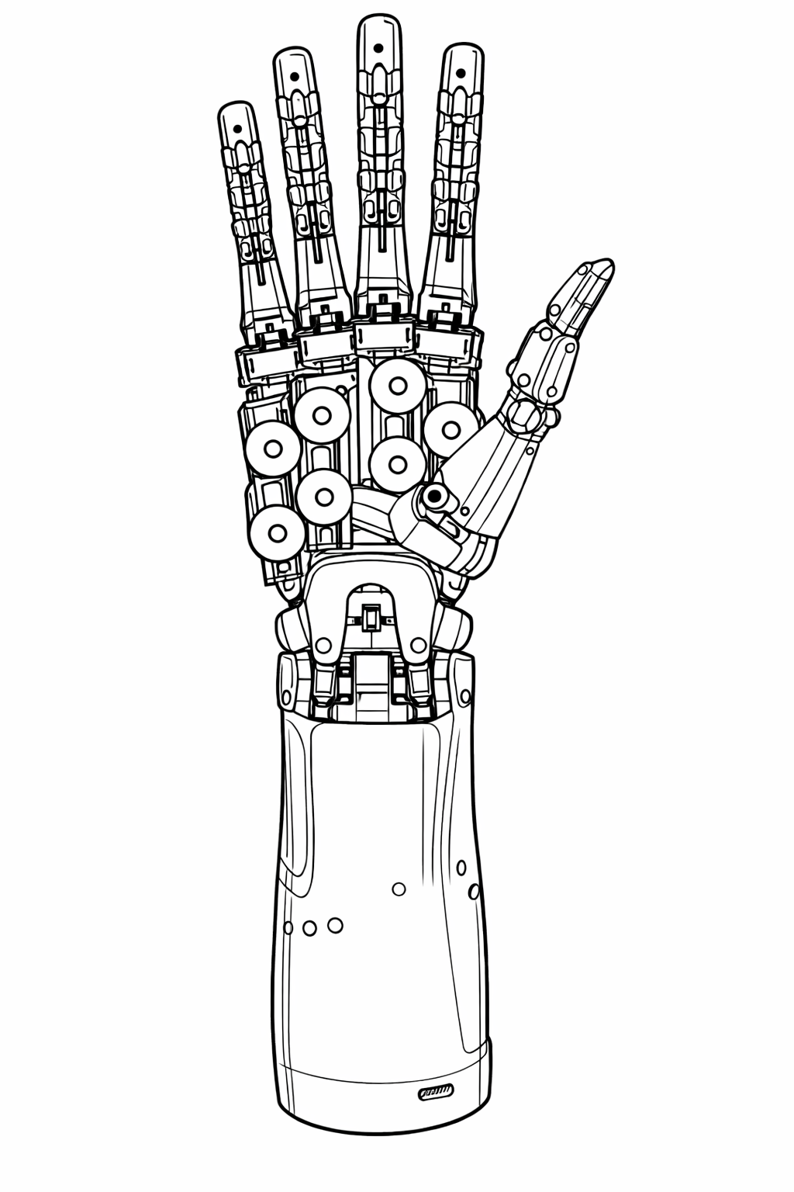
Thank you for listening!
Team Members: Jincheng Tian, GuangTian Liu, ZhongHao Zhao
2026/3/11

